Slide 1



Basic CRUD
MongoDB, ORM, Mongoose and CRUD Operations
SoftUni Team
Technical Trainers
Software University
http://softuni.bg

Slide 2
Table of Content
Mongo DB Configurations
Install & Start
GUI
Object-Relational Mapping (ORM)
Mongoose Introduction
Overview
Schemas & Models
Basic CRUD with MongoDB & Mongoose

Slide 3
Have a Question?
sli.do
#tech-fund

Slide 4

MongoDB Configurations
Install and Start MongoDB, GUI

Slide 5
MongoDB
Free open-source cross-platform document-oriented program
Uses JSON-like documents with schemata.
Good for e-commerce product catalog, blogs, evolving data requirements
Loosely coupled objectives – the design may change by over time.

Slide 6

Developer Tools
Robo 3T
Fully featured IDE with embedded shell
Visual Query Builder
IntelliShell with Auto-Completion
Alternatives (NoSQLBooster)
Shell-centric cross platform GUI
Fluent Query Builder

Slide 7
Install MongoDB
Download from: https://www.mongodb.com/download-center
When installed, MongoDB needs a driver
One to use with Node.js, .NET, Java, etc..
Install MongoDB driver for Node.js:
npm install mongodb -g

Slide 8
Configure MongoDB
Additional configurations are needed:
Go to installation folder and run a command prompt as an administrator
Type the following command:
Additional information at: https://docs.mongodb.com/manual/tutorial/install-mongodb-on-windows/
Usually in C:\Program Files\MongoDB\Server\3.4\bin
"path to mongod.exe" mongod --dbpath "path to store data"

Slide 9
Run MongoDB as a Windows Service
Instead of always opening a CMD we can run MongoDB as a service
After that just type 'net start MongoDB' and the database now runs as a service
Additional information: https://www.mkyong.com/mongodb/how-to-run-mongodb-as-windows-service/
mongod -–dbpath "C:\mymongodb" –-logpath "C:\mymongodb\logs.txt" –-install –-serviceName "MongoDB"

Slide 10
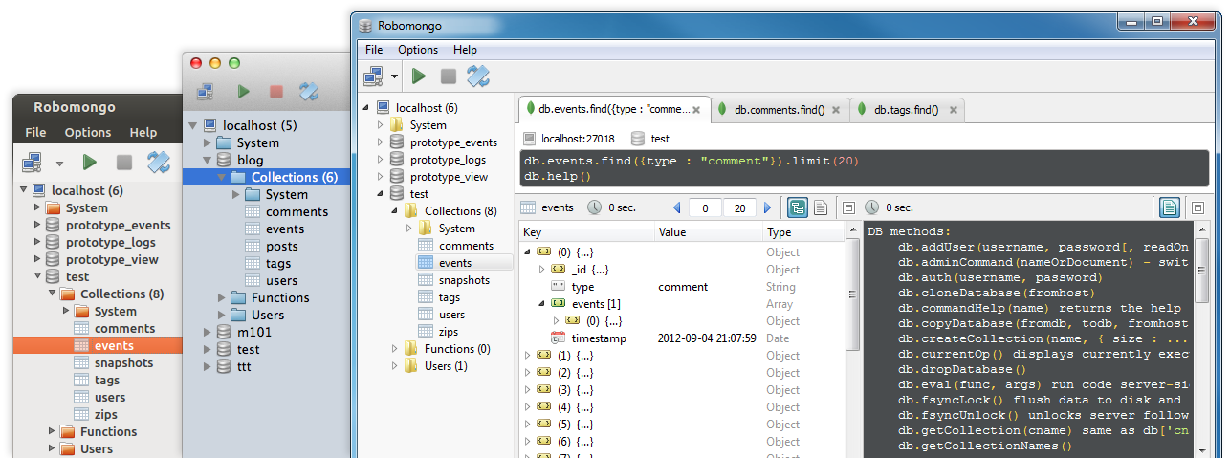
Working with MongoDB GUI
Choose one of the many
For example:
Robo 3T -> https://robomongo.org/download
MongoBooster -> https://mongobooster.com/downloads

Slide 11

Object-Relational Mapping
Overview, Advantages and Disadvantages

Slide 12

ORM Overview
ORM Frameworks maps OOP classes to database tables
JS
Object
Mapping Logic
Object in Memory
Database

Slide 13
ORM Advantages
Developers can only focus on business logic rather than writing interfaces between code and db
Reduces development time and costs by avoiding redundant codes
Capable of connecting to different databases, which comes handy during switching from one db to the other
Helps to effectively query from multiple tables

Slide 14
ORM Disadvantages
Loss in developer productivity whilst they learn to program with ORM
Developers lose understanding of what the code is actually doing - the developer is more in control using SQL
ORM has a tendency to be slow
ORM fails to compete against SQL queries for complex queries

Slide 15
Mongoose Introduction
Overview, Mongoose Schemas, Validation, Models

Slide 16
Mongoose Overview
Mongoose is a object-document model module in Node.js for MongoDB
It provides a straight-forward, schema-based solution to model your application data.
Includes build-in type casting and validation
Extends the native queries (much easier to use)
To install type in CMD:
npm install mongoose --save

Slide 17
Working with Mongoose in Node.js
Load the following module:
Connecting to the database:
const mongoose = require('mongoose')
mongoose.connect('mongodb://localhost:27017/myapp')
Connect to the database using mongoose module

Slide 18
Mongoose Schemas
Everything in Mongoose starts with a Schema.
Each schema maps to a MongoDB collection and defines the shape of the documents within that collection.
const Schema = mongoose.Schema;
const studentSchema = new Schema({
name: String,
age: Number,
grades: Array
});
Define Schema types. Each entity property could be validated.

Slide 19
Mongoose Validations
Mongoose has built-in schema validations to protect from invalid data entity insertion
const studentSchema = new Schema({
name: { type: String, required: true },
age: { type: Number, min: 6, max: 18 },
grades: [ { type: Number, min: 2, max: 6 } ]
})

Slide 20
Mongoose Models
Models are fancy constructors compiled from Schema definitions
An instance of a model is called a document
Models are responsible for creating and reading documents from the underlying MongoDB database
const Student = mongoose.model('Student', studentSchema);
Name of the collection your model is for
The Model Schema

Slide 21
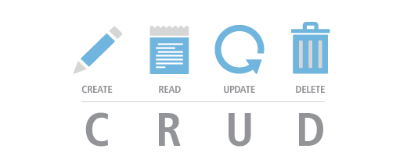
Basic CRUD with MongoDB & Mongoose
Create, Read, Update, Delete

Slide 22
Create an Entity
This is how we can create new items in the database
This will commonly be from an HTTP POST request, although you can do this anywhere you want:
Student.create({
name: 'George',
age: 12,
grades: [4, 5, 2]
})
.then((data) => console.log(data))
.catch((err) => console.error(err))
CRUD operations inside a database are asynchronous

Slide 23
List Entities
To retrieve all entities from a collection use the following:
To fetch only one student by id use the following:
Student.find({})
.then((students) => console.log(students))
.catch((err) => console.error(err))
Will return an array with all students from the collection
Student.findById(id)
.then((student) => console.log(student))
.catch((err) => console.error(err))
Will return a single object from the collection

Slide 24
List Entities (2)
To filter by given criteria you can insert an object inside find:
To filter a single object by given criteria use the following:
Student.find({ name: 'George', age: 7 })
.then((students) => console.log(students))
.catch((err) => console.error(err))
Will return an array with all students that answer to the given criteria.
Will return a single object. The first entity that matches the given criteria.
Student.findOne({ name: 'George', age: 7 })
.then((student) => console.log(student))
.catch((err) => console.error(err))

Slide 25
Update an Entity
To update an entity we need the entity id and the properties you want to modify as an object. After that use the findByIdAndUpdate method:
Student.findByIdAndUpdate(id, { age: 13 })
.then((student) => console.log(student))
.catch((err) => console.error(err));
Will return the old entity. List them again to see the updated one.

Slide 26
Delete an Entity
Deleting can be done by id and using the findByIdAndRemove method:
To delete many entities by criteria use the following:
Will return a single object. The entity that has been deleted.
Student.findByIdAndRemove(id)
.then((student) => console.log(student))
.catch((err) => console.error(err));
Will return a single object with information how many entities have been deleted.
Student.deleteMany({ name: 'Rick' })
.then((data) => console.log(data))
.catch((err) => console.error(err));

Slide 27
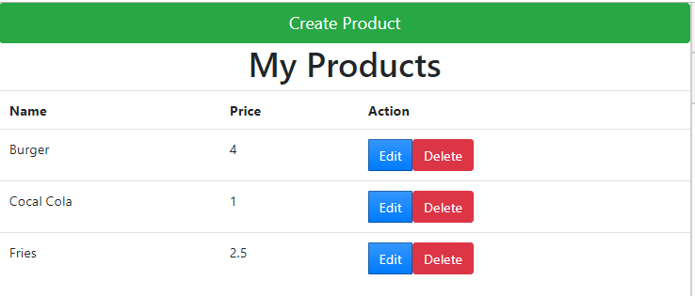
Problem: Simple Products Store
Write an application that Creates, Lists, Edits and Deletes products
Use Node.js, Express.js, MongoDB and Mongoose ORM

Slide 28

Live Exercises

Slide 29

Summary
…
…
…
ORM is used to map objects to database tables
Mongoose is a object-document model module in Node.js for MongoDB
It uses Schemas & Models to connect with the database
Basic CRUD operations are done using the Mongoose models

Slide 30
https://softuni.bg/courses/technology-fundamentals

Slide 31













SoftUni Diamond Partners

Slide 32


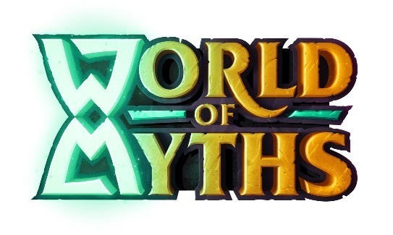


SoftUni Organizational Partners

Slide 33




Trainings @ Software University (SoftUni)
Software University – High-Quality Education and Employment Opportunities
softuni.bg
Software University Foundation
http://softuni.foundation/
Software University @ Facebook
facebook.com/SoftwareUniversity
Software University Forums
forum.softuni.bg

Slide 34

License
This course (slides, examples, demos, videos, homework, etc.) is licensed under the "Creative Commons Attribution-NonCommercial-ShareAlike 4.0 International" license

